Slide 1
CHAPTER 5
Software Coding
And
Testing
Dhara Sharma Dept. of Computer Engineering LJ Polytechnic

Slide 2
Software Coding and Testing
Software Testability
S/w testability is simply how easily system or program or product can be tested.
Testing must exhibit set of characteristics that achieve the goal of finding errors with a minimum of effort.
Characteristics of s/w Testability:
Operability - “The better it works, the more efficiently it can be tested”
Relatively few bugs will block the execution of tests.
Allowing testing progress without fits and starts
Dhara Sharma Dept. of Computer Engineering LJ Polytechnic

Slide 3
Software Coding and Testing
Software Testability
Observability - "What you see is what you test.“
Distinct output is generated for each input.
System states and variables are visible or queriable during execution.
Incorrect output is easily identified.
Internal errors are automatically detected & reported.
Source code is accessible.
Controllability - "The better we can control the software, the more the testing can be automated and optimized.“
Software and hardware states and variables can be controlled directly by the test engineer.
Tests can be conveniently specified, automated, and reproduced.
Decomposability - By controlling the scope of testing, we can more quickly isolate problems and perform smarter retesting.
Independent modules can be tested independently.
Dhara Sharma Dept. of Computer Engineering LJ Polytechnic

Slide 4
Software Coding and Testing
Software Testability
Simplicity - The less there is to test, the more quickly we can test it."
Functional simplicity (e.g., the feature set is the minimum necessary to meet requirements).
Structural simplicity (e.g., architecture is modularized to limit the propagation of faults).
Code simplicity (e.g., a coding standard is adopted for ease of inspection and maintenance).
Stability - "The fewer the changes, the fewer the disruptions to testing."
Changes to the software are infrequent.
Changes to the software are controlled.
Changes to the software do not invalidate existing tests.
Understandability – "The more information we have, the smarter we will test."
Dependencies between internal, external, and shared components are well understood.
Changes to the design are communicated to testers.
Technical documentation is instantly accessible, well organized, specific and detailed, and accurate.
Dhara Sharma Dept. of Computer Engineering LJ Polytechnic

Slide 5
Software Coding and Testing
Testing Attributes
A good test has a high probability of finding an error.
Tester must understand the software and attempt to develop a mental picture of how the software might fail.
A good test is not redundant.
Testing time and resources are limited.
There is no point in conducting a test that has the same purpose as another test.
Every test should have a different purpose
Ex. Valid/ invalid password.
A good test should be “best of breed”
In a group of tests that have a similar intent, time and resource limitations may mitigate toward the execution of only a subset of these tests.
A good test should be neither too simple nor too complex.
sometimes possible to combine a series of tests into one test case, the possible side effects associated with this approach may mask errors.
Each test should be executed separately
Dhara Sharma Dept. of Computer Engineering LJ Polytechnic

Slide 6
Software Coding and Testing
Test Case Design
Objectives of testing, we must design tests that have the highest likelihood of finding the most errors with a minimum amount of time and effort.
Test case design methods provide a mechanism that can help to ensure the completeness of tests and provide the highest likelihood for uncovering errors in software.
Any product or system can be tested on two ways:
Knowing the specified function that a product has been designed to perform; tests can be conducted that demonstrate each function is fully operational while at the same time searching for errors in each function (Black Box)
knowing the internal workings of a product, tests can be conducted to ensure that "all gears mesh," that is, internal operations are performed according to specifications and all internal components have been effectively exercised. (White box testing)
Dhara Sharma Dept. of Computer Engineering LJ Polytechnic

Slide 7
Software Coding and Testing
White Box Testing
White-box testing of software is predicated on close examination of procedural detail.
Logical paths through the software are tested by providing test cases that exercise specific sets of conditions and/or loops.
The "status of the program" may be examined at various points.
White-box testing, sometimes called glass-box testing, is a test case design method that uses the control structure of the procedural design to derive test cases.
Dhara Sharma Dept. of Computer Engineering LJ Polytechnic

Slide 8
Software Coding and Testing
White Box Testing
Using this method, SE can derive test cases that
Guarantee that all independent paths within a module have been exercised at least once
Exercise all logical decisions on their true and false sides,
Execute all loops at their boundaries and within their operational bounds
Exercise internal data structures to ensure their validity.
A sequence of process boxes and decision diamond can map into a single node.
The arrows on the flow graph, called edges or links, represent flow of control and are parallel to flowchart arrows.
An edge must terminate at a node, even if the node does not represent any procedural statement.
Areas bounded by edges and nodes are called regions. When counting regions, we include the are outside the graph as a region.
When compound condition are encountered in procedural design, flow graph becomes slightly more complicated.
Dhara Sharma Dept. of Computer Engineering LJ Polytechnic

Slide 9
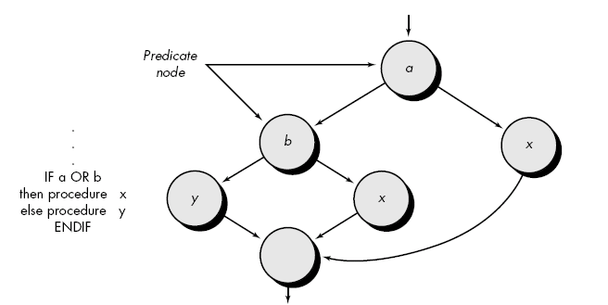
Software Coding and Testing
White Box Testing
Dhara Sharma Dept. of Computer Engineering LJ Polytechnic

Slide 10
Software Coding and Testing
Black Box Testing
Also called behavioral testing, focuses on the functional requirements of the software.
It enables the software engineer to derive sets of input conditions that will fully exercise all functional requirements for a program.
Black-box testing is not an alternative to white-box techniques but it is complementary approach.
Black-box testing attempts to find errors in the following categories:
Incorrect or missing functions,
Interface errors,
Errors in data structures or external data base access.
Behavior or performance errors,
Initialization and termination errors.
Dhara Sharma Dept. of Computer Engineering LJ Polytechnic

Slide 11
Software Coding and Testing
End
Of
Chapter
Dhara Sharma Dept. of Computer Engineering LJ Polytechnic

